Slide 1
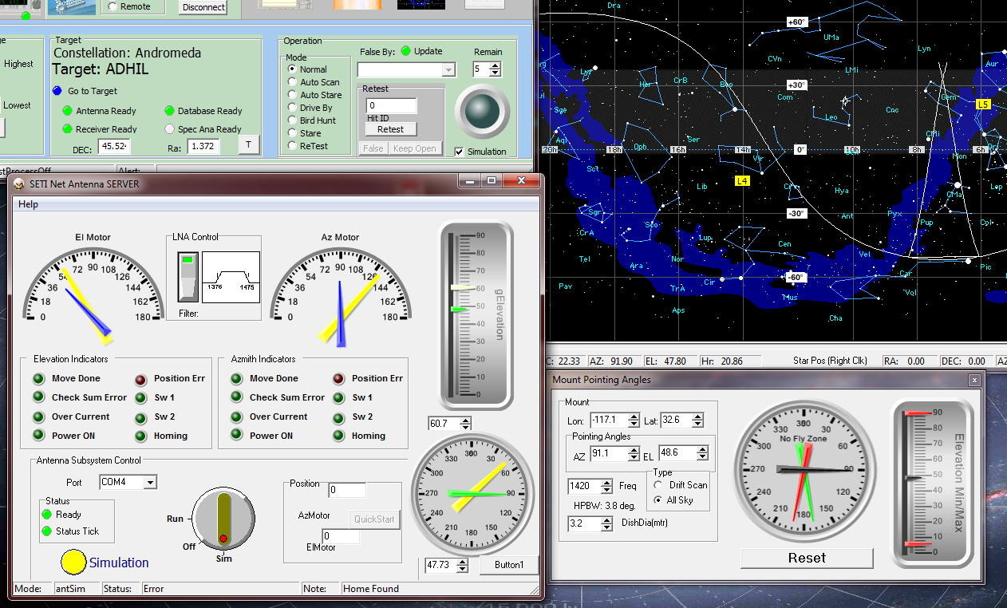
Tmr
Draw Antenna
Properties
Azimuth
Elevation
NewAntAvable?
Yes

