Slide 1
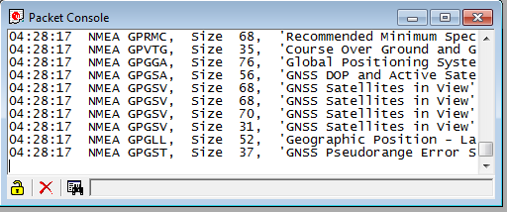
U-center application
ERGO Shield
USB
ublox
To ERGO
Server
Wiz
NET
Ethernet
ATMEGA
328
Serial USB
Ethernet Arduino
Visual Studio
application
Signal Flow.pptx 2012-10-22

