Slide 1
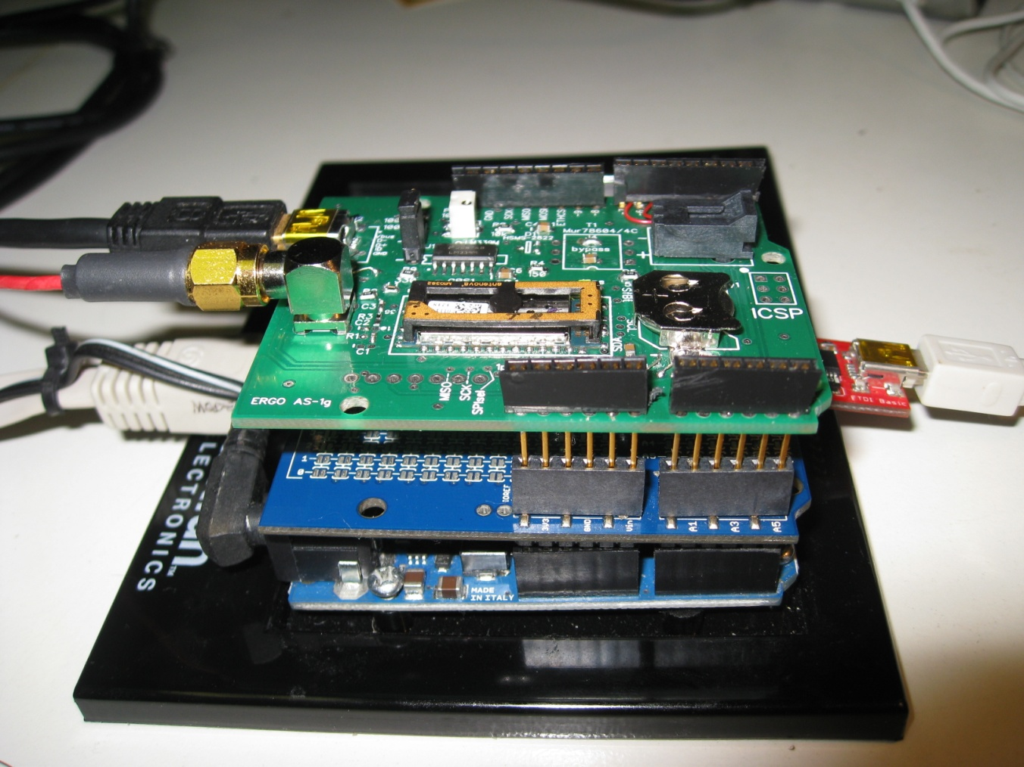
USB back to u-center
Ublox GPS Module
USB back to VS debugger
GPS Antenna
Ethernet to Server
Ergo Shield
In-between Shield
Arduino Ethernet

