Slide 1
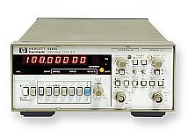
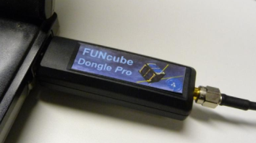
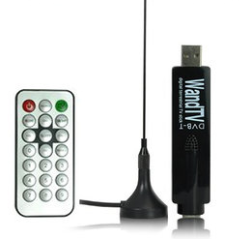
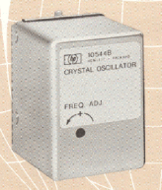
SETI Net System Frequency Standard
Down East
Weak Signal Source
18 MHz Osc.
1.4 GHz
Filter
R7000 Receiver
R7000 Receivers
Windfreak Synthesizer
10 MHz
FUNcube Dongle
Receiver
10 MHz
HP 5316B
Counter
GPS Frequency Standard Controller
GPS Ant.
1 pps
Synergy Systems GPS Receiver
Control
HP 10544C
Oscillator
DVB-T Stick Tuner
Frequency Standard.pptx 2012-04-28

