Slide 1
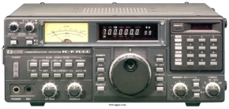
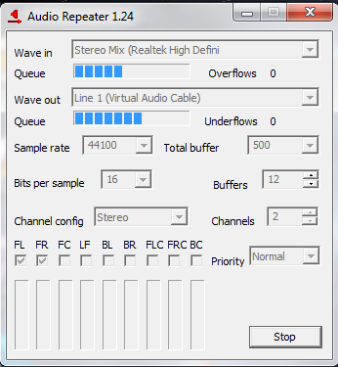
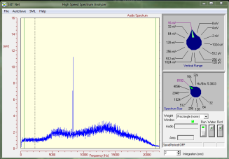
Line In
Virtual Audio Cable #1
Recorder
Receiver
Mixer
System
Sounds
Spec Ana
Mixer to VAC
Audio Repeater
Audio Setup
2011-03-09
Line In to Speaker
Audio Repeater

