Slide 1
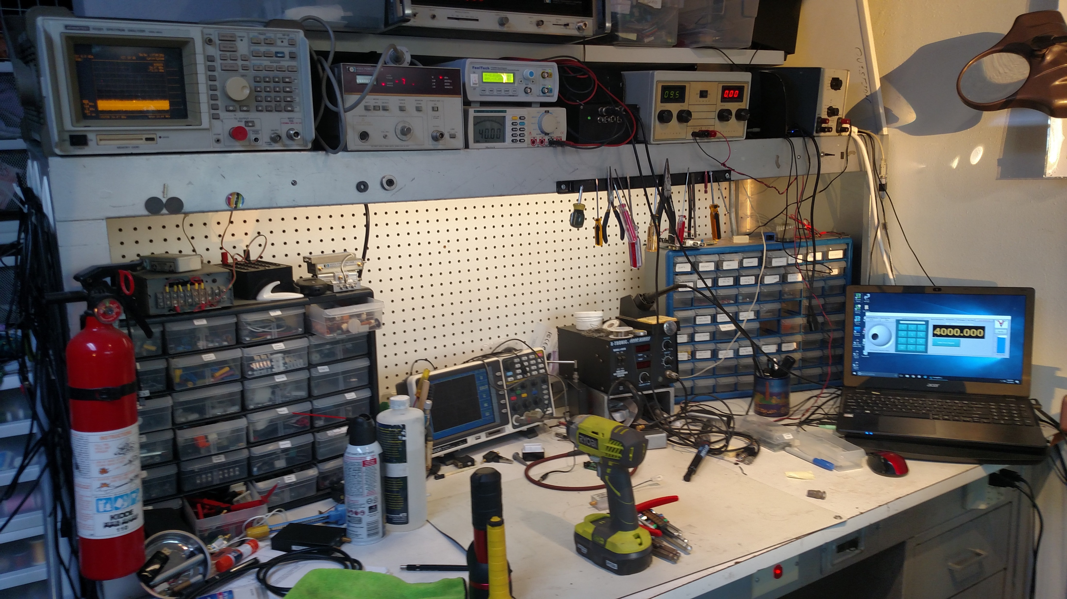
uWave Counter
HP 5340A
Function Gen
FeelTech
SpecAna
Advantest R3365
Power Meter
HP 436/8484A
Bench Power Supply
0 – 35 v
DMM
Masteck M9803R
GPS Disciplined Clock
Lady Heather
Soldering /Hot Air Rework
K-Tronic
Acer Laptop
Running Synthesizer
‘Scope
Owon MSO8102T

