Slide 1
SETI Network
Only amateur search for uWave ET
www.SETI.Net
@SETINet
SETI@SETI.Net
James Brown W6KYP

Slide 2
Short (very short) History
First Computer About
All Projects http://www.seti.net/indepth/history/history.php
Old Guy Stuff

Slide 3
SETI Where to look for What
Gravity waves
Wo Wo forces
Electromagnetic
Above Optical
Optical – Lick Observatory, Harvard and Boquete in Panama – Corm Laser
Microwave
ATA – Pulse, Radar
Greenbank - Pulse, leakage
Parks – ?
Arecibo – Rader, ?
China - ?
SETI Net – I’m Here Beacon & Data/Control to L4 and L5

Slide 6
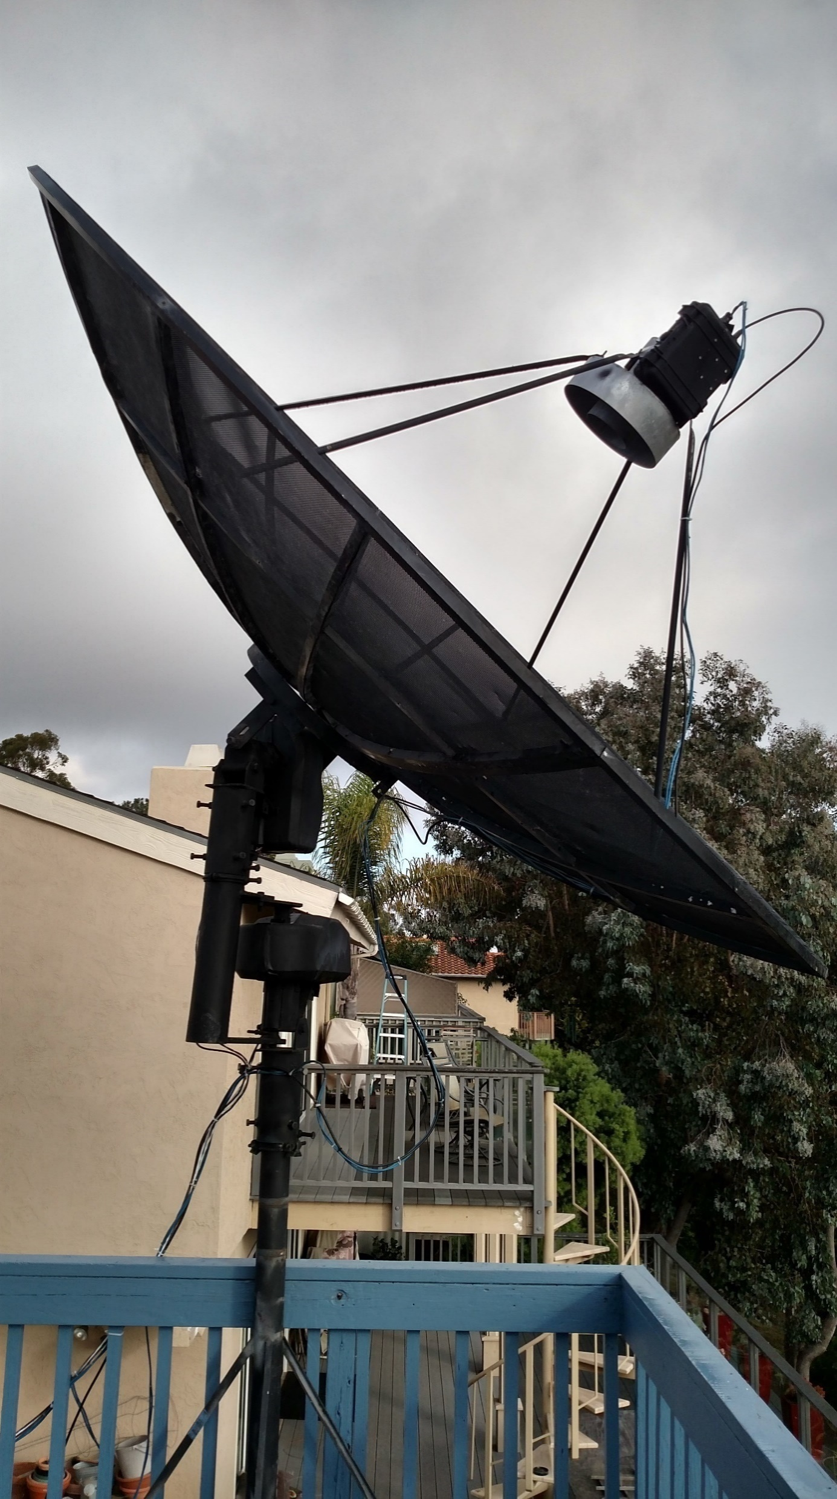
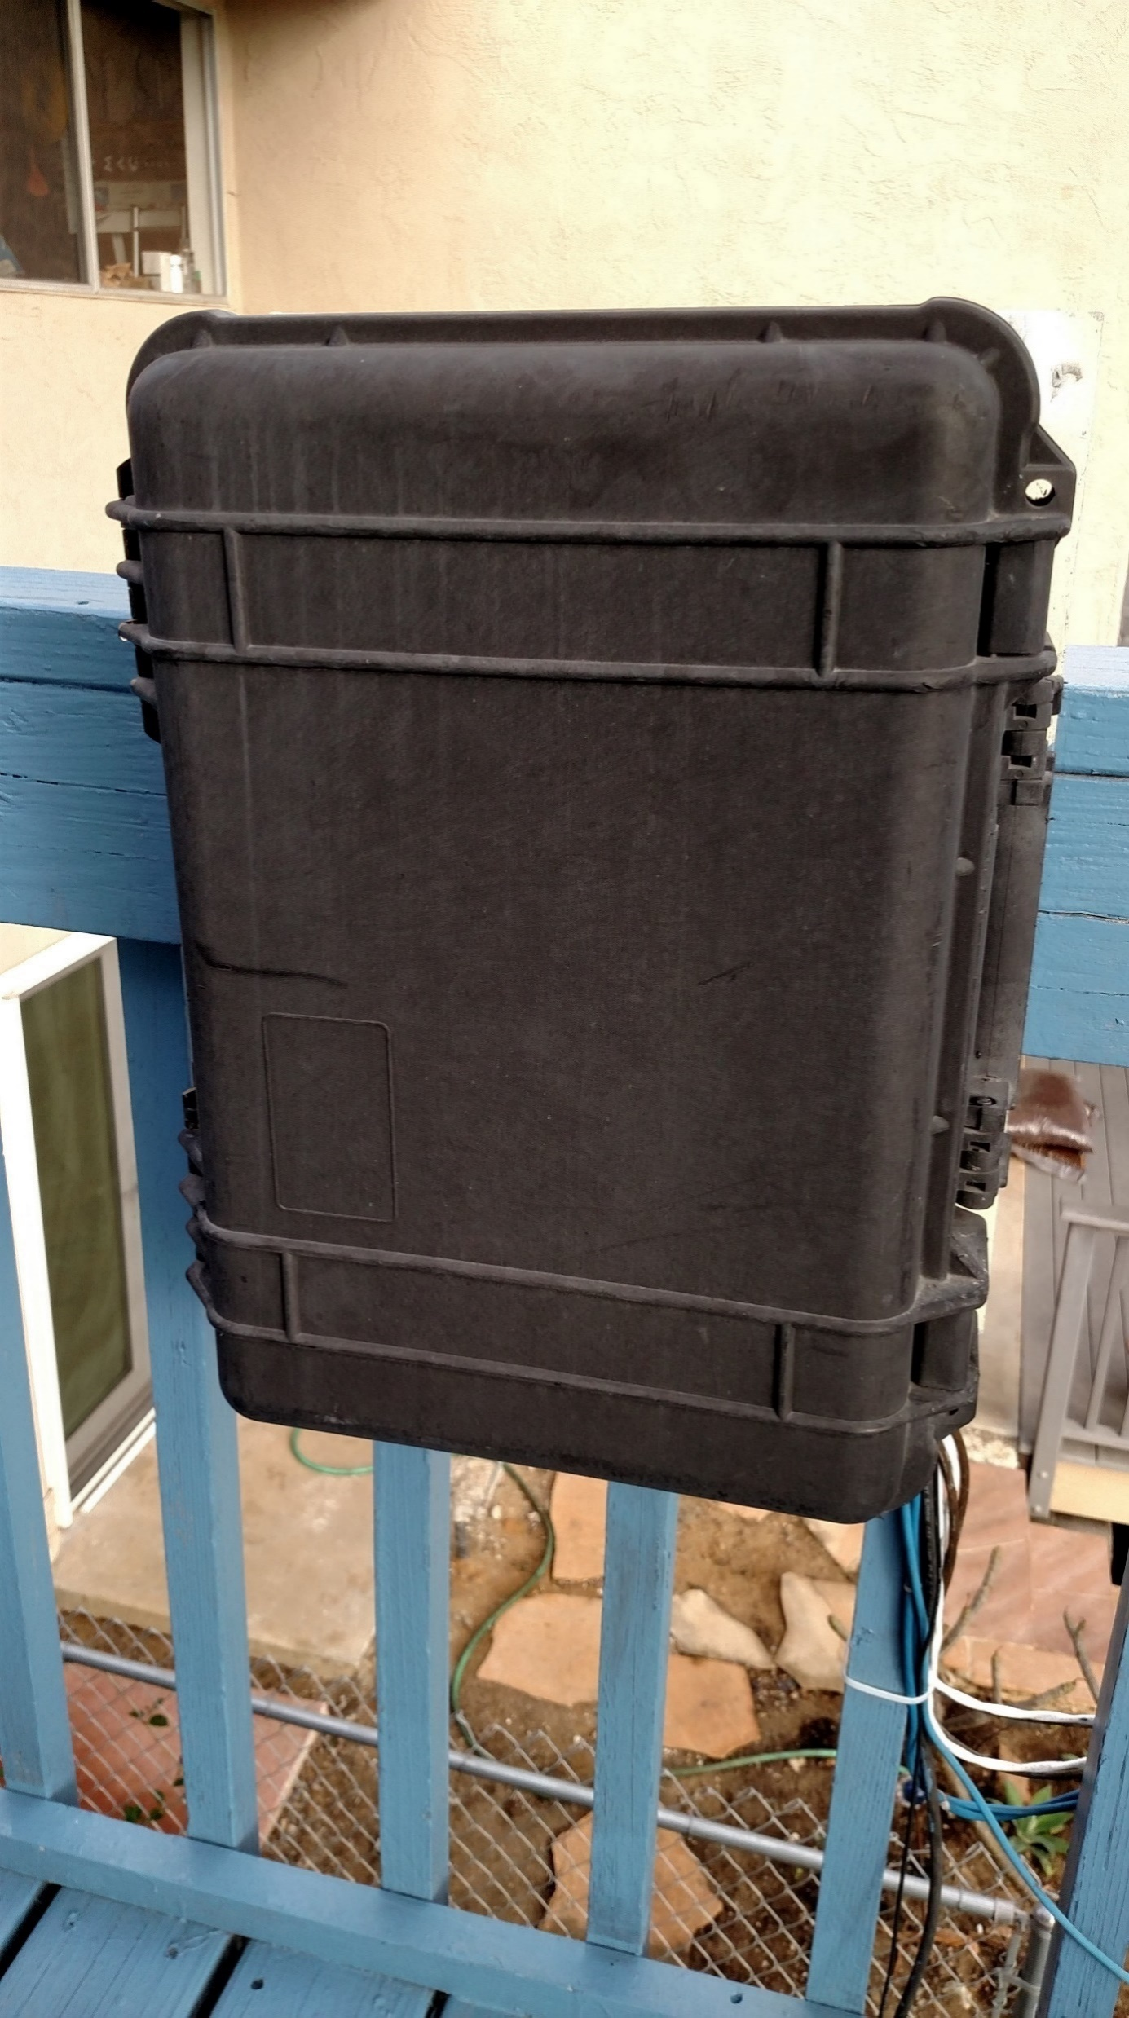
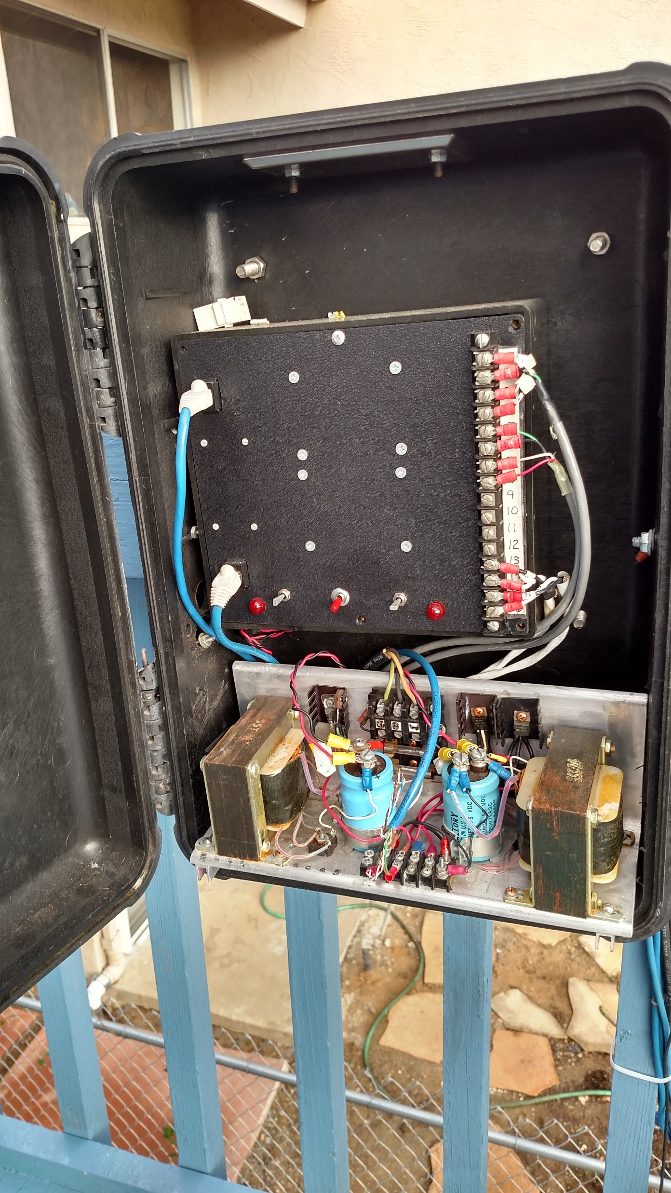
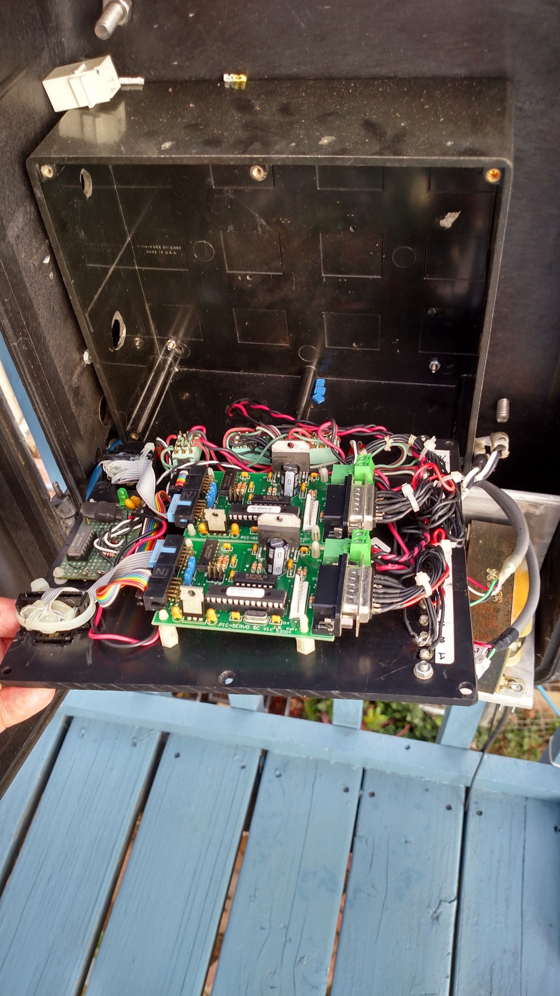
What to look for and HOW
My Self - An Epiphany
System Block Diagram - http://www.seti.net/Operations/Operations.php

Slide 7
Videos of the operation
1. Control Box https://youtu.be/Y9gXgBzUFjY?t=8
2. Bringing it up https://www.youtube.com/watch?v=1aIcbUVN0do
3. Home - https://youtu.be/Gp1FfotNvaA
4. Connect to SDR Sharp https://youtu.be/JI8wsxe8mTU
5. HackRF - https://youtu.be/x5Iq94t_wHI
6. Waterhole https://youtu.be/7c0DWWZKL6c
7. SigGen - https://youtu.be/F89ld9ZaXdM

Slide 8
Detection Algorithm Step by Step
Build a large array of samples
Chirp receiver to match Earths Doppler
At the end of collection calculate average bin weight
Scan averages for neighborhood above average
Turn on recording subsystem
Alert operator
Move to web site.

Slide 9
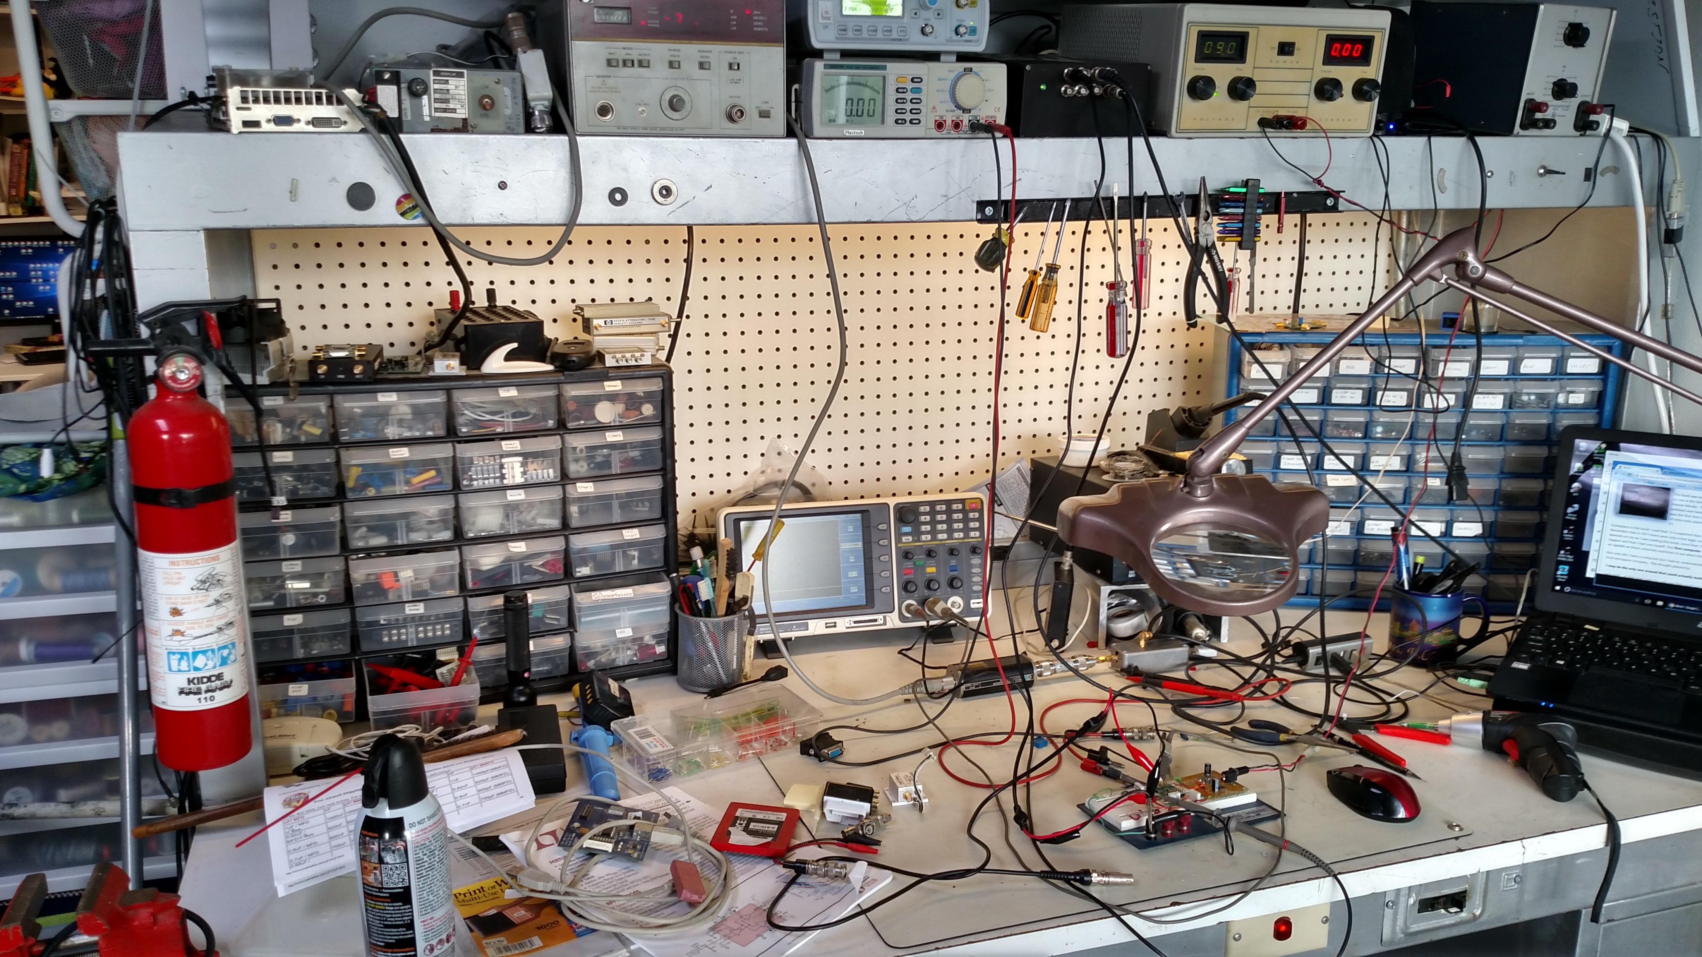
What’s Next
Shadow ATA
‘C’ Band Horn,LNA, Filter
Other band?
Your ideas here.

