Slide 1
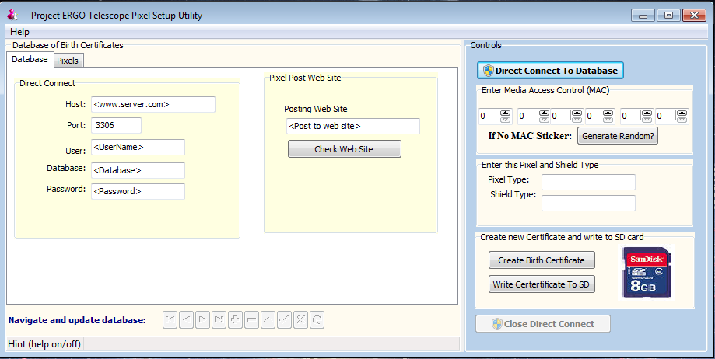
2. Web site pixel will post its data to
3.Click to login
1. Login Credentials from system administrator
You can turn the hints on and off through the Help menu (top left)
File: PixelBirthdayInitial.pptx

