Slide 1

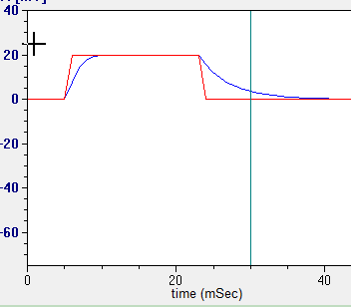
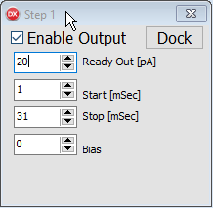
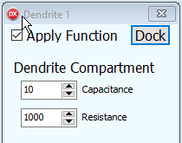
Dispatch Source
  Send zeros
Dispatch Sink
  Send ‘Source out’
  to ‘Sink in’
Step1
Dendrite 1
Tag
Tag
Last Output
Last Output
2. 20 pA
1. Zeros
Function
Function
Input
Input
Function Parameters
Function Parameters
Dispatch 2019-09-10

