Slide 1
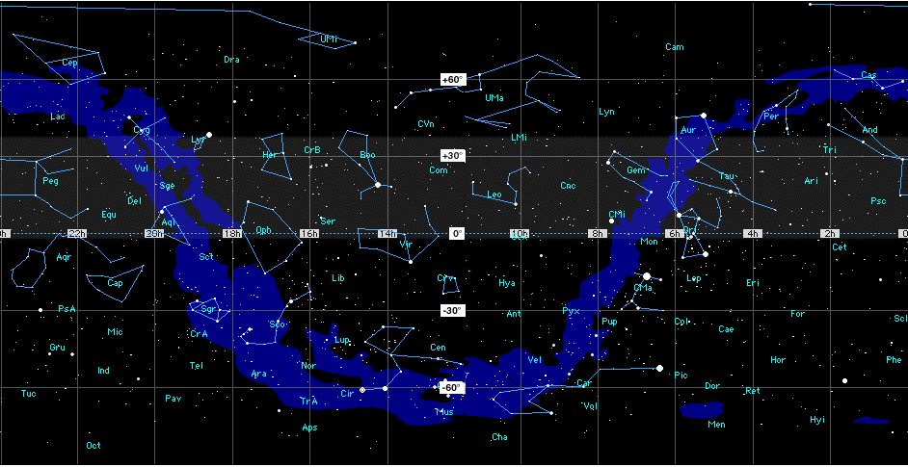
DataBaseOnSkyMap 2011-12-11

