Slide 1
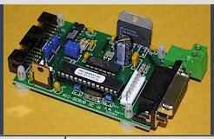
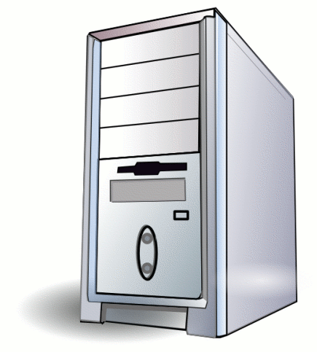
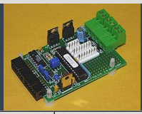
Antenna Rotors
Control Box
Az Motor
Shaft Encoder
RS 232 to RS 485
Cat 5
RJ-45 to 10 Pin Header Cable
Limit
Control Box to Rotor cable
RJ-45 to 10 Pin Header Cable
El Motor
Shaft Encoder
Limit
Sagan
Temp
Head End Electronics
Filter Relay
Cat 5
RJ-45 to 10 Pin Header Cable
Temp
Interconnection.ppx 2018-03-31
ADC

