Slide 1
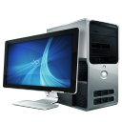
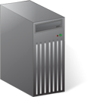
Pixel
Pixel
Work Station
Work Station
Database server at www.ERGOtelescope.org
Pixel
ERGO System Block Diagram
2012-07-28
Work Station

