Slide 1
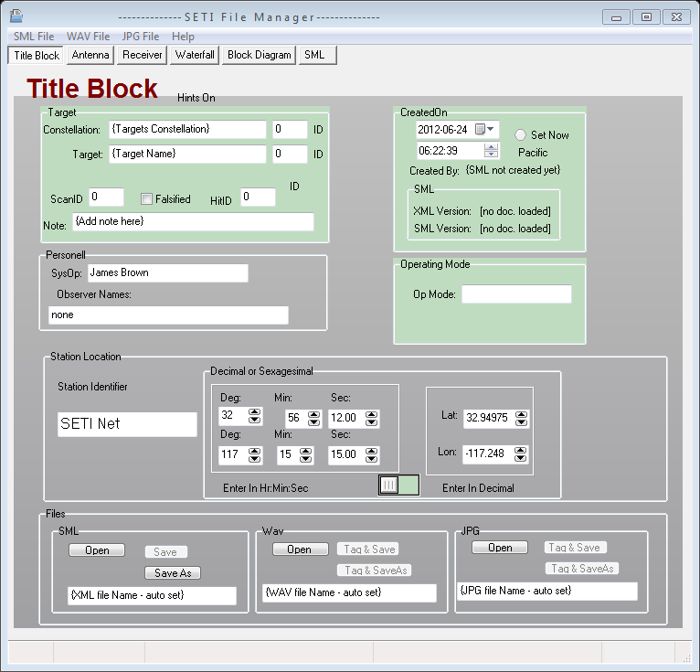
Tabs
File Type Selector
2012-07-09

